Slide 1
Outline
Why ranked retrieval?
Term frequency
tf-idf weighting
The vector space model

Slide 2
Binary incidence matrix
 | Anthony and Cleopatra | Julius Caesar | The Tempest | Hamlet | Othello | Macbeth . . .
ANTHONY BRUTUS CAESAR CALPURNIA CLEOPATRA MERCY WORSER . . . | 1 1 1 0 1 1 1 | 1 1 1 1 0 0 0 | 0 0 0 0 0 1 1 | 0 1 1 0 0 1 1 | 0 0 1 0 0 1 1 | 1 0 1 0 0 1 0
Each document is represented as a binary vector ∈ {0, 1}^{|V|.}
‹#›
Notes:
We have already come across the binary incidence matrix where each document is represented as a binary vector ∈ {0, 1}^{|V|.}
A value of 1 means that the term appears in the document, and a value of 0 means that the term does not appear in the document.

Slide 3
Count (frequency) matrix
 | Anthony and Cleopatra | Julius Caesar | The Tempest | Hamlet | Othello | Macbeth . . .
ANTHONY BRUTUS CAESAR CALPURNIA CLEOPATRA MERCY WORSER . . . | 157 4 232 0 57 2 2 | 73 157 227 10 0 0 0 | 0 0 0 0 0 3 1 | 0 2 2 0 0 8 1 | 0 0 1 0 0 5 1 | 1 0 0 0 0 8 5
Each document is now represented as a count vector ∈ N^{|V|.}
‹#›
Notes:
Now let‘s have a look at the count (or freuqency) matrix. Each element or value is the frequency of a term in a document. In other words, the number of times a term occurs in a partcular document. So, longer documents will naturally have higher frequencies of terms, the longer the document, the more terms and higher frequency values it will have.

Slide 4
Binary → count → weight matrix
 | Anthony and Cleopatra | Julius Caesar | The Tempest | Hamlet | Othello | Macbeth . . .
ANTHONY BRUTUS CAESAR CALPURNIA CLEOPATRA MERCY WORSER . . . | 5.25 1.21 8.59 0.0 2.85 1.51 1.37 | 3.18 6.10 2.54 1.54 0.0 0.0 0.0 | 0.0 0.0 0.0 0.0 0.0 1.90 0.11 | 0.0 1.0 1.51 0.0 0.0 0.12 4.15 | 0.0 0.0 0.25 0.0 0.0 5.25 0.25 | 0.35 0.0 0.0 0.0 0.0 0.88 1.95
Tf is the local term frequency (local frequency) (i.e. Number of terms t appears in doc d)
Idf is the global frequency of a term across a document collection. ) (i.e. Number of terms t appears in document collection C)
Each document is now represented as a real-valued vector of tf-idf weights ∈ R^{|V|.}
Next slides show how to calculate tf-idf
‹#›
Notes:
Tf is the term frequency (local frequency)
Idf is the global frequency of a term across a document collection.
Tf is the local term frequency (local frequency) (i.e. Number of times term t appears in doc d)
Idf is the global frequency of a term across a document collection. ) (i.e. Number of terms t appears in document collection C). Each document is now represented as a real-valued vector of tf-idf weights.

Slide 5
Bag of words model
We do not consider the order of words in a document.
Doc 1: John is quicker than Mary
Doc 2: Mary is quicker than John
Doc 1 and Doc 2 are represented the same way.
This is called a bag of words model
‹#›
Notes:
A bag of words model does not consider the order of words in a document.
John is quicker than Mary and Mary is quicker than John are represented the same way.
This is called a bag of words model.
The positional index is able to distinguish these two documents. However, for now it is important to focus on understanding the bag of words model.

Slide 6
Term frequency tf
The term frequency tf_{t,d} of term t in document d is defined as the number of times that t occurs in d.
A document with tf = 10 occurrences of the term is more relevant than a document with tf = 1 occurrence of the term. But it is not 10 times more relevant.
Relevance does not increase proportionally with term frequency.
Therefore we can use local term weighting to adjust the raw term frequency value.
‹#›
Notes:
The frequency of term in document is defined as the number of times that it occurs in a document.
We normally want to use tf when computing query-document match scores.
However, bare in mind that sometimes raw term frequency is not ideal, and the best way to explain this is via an example.
A document about football with the word football occurring 10 times of the term is more relevant than a document where the term football appears once but it is not 10 times more relevant. Therefore, relevance does not increase proportionally with term frequency.
Note that tf-idf, tf means raw term frequency, and idf global term weighting scheme is a very popular scheme and we don‘t always have to adjust the local term weight, especially since as we will see later on we will adjust the value of terms based on the length of the documents.
Often, the best way when it comes to choosing a weighting scheme, is to try out several weighting schemes and decide on the best one based on the results of experiments.

Slide 7

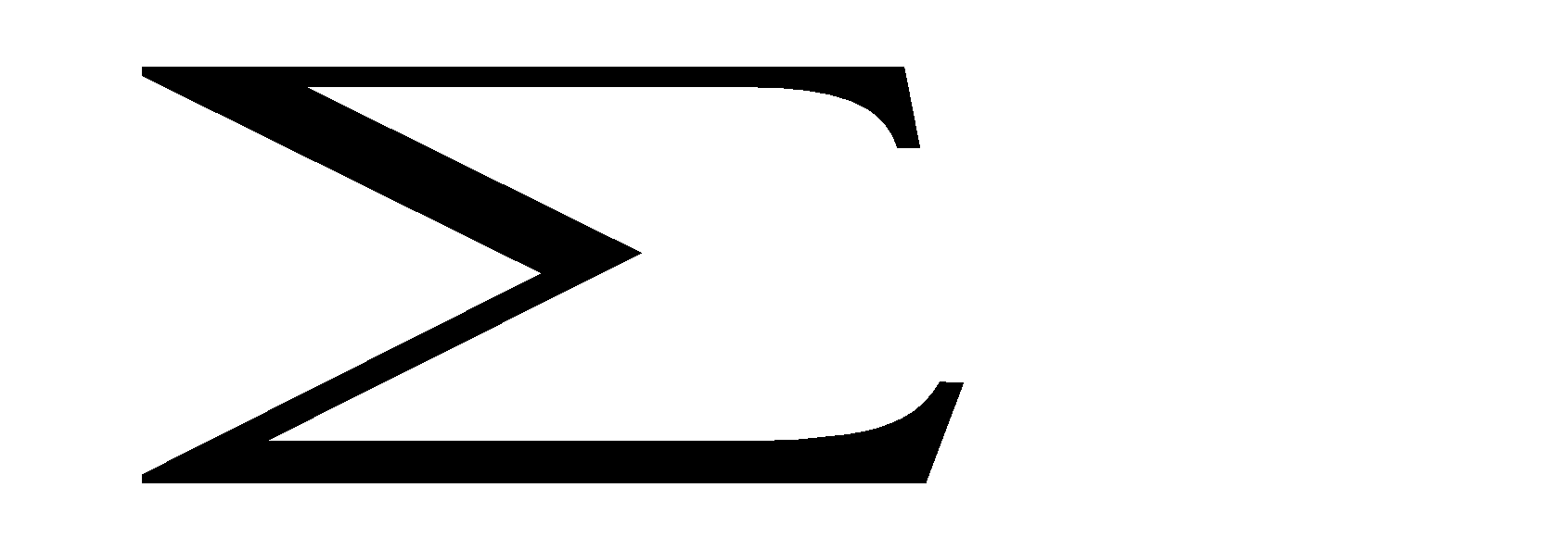
Instead of raw frequency: Log frequency weighting
The log frequency weight of term t in d is defined as follows
tf_{t,d} → w_{t,d} :
0 → 0, 1 → 1, 2 → 1.3, 10 → 2, 1000 → 4, etc.
Score for a document-query pair: sum over terms t in both q and d: tf-matching-score(q, d) = _{t∈q∩d} (1 + log tf_{t,d} )
The score is 0 if none of the query terms is present in the document.
in both q and d
spend a couple of mins looking at the notes of the slide
‹#›
Notes:
Instead of raw frequency we can use the Log frequency weighting
The log frequency weight of term t in document d is defined on the slide.
So according to the formula for weight, the term t in d is defined as 1+log10(of the frequency of a term)
0 remains 0 because the base 10 of logarithm of zero is not defined, it does not exist. So, this remains 0. The score is 0 if none of the query terms is present in the document.
1+log10(1)=1+0=1
1+log10(2)=1+0.3=1.3
1+log10(10)=1+1=2
1+log10(1000)=1+3=4
The score for a document-query pair: sum over terms t in both q and d:
tf-matching-score(q, d) = Sum_{t∈q∩d} (1 + log tf_{t,d} )
So assume that the frequencies are of those of terms that appear in both the query and the document have frequencies (1, 2, 10, 1000) then we compute the log frequency weight of each term in document using the tf-matching-score formula.
So, let‘s take the bracket first. This computes the weight of a term t in a document d. Then we only Sum the log frequency weight of the terms that appear in both the query and the document. Hence, the intersection of two sets q and d, denoted by q ∩ d, is the set containing all terms found in the query q that also belong to the document d.
(0+1+1.3+2+4)=8.3 is the score for the document-query pair.

Slide 8
Instead of raw frequency: Log frequency weighting
The log frequency weight of term t in d is defined as follows
Term frequencies: 0 ,1, 2, 10, 1000
To apply log frequency:
tf_{t,d} → w_{t,d} : 0 → 0, 1 → 1, 2 → 1.3, 10 → 2, 1000 → 4, etc.
1+log10(1)=1+0=1
1+log10(2)=1+0.3=1.3
1+log10(10)=1+1=2
1+log10(1000)=1+3=4
‹#›
Notes:
Instead of raw frequency we can use the Log frequency weighting
The log frequency weight of term t in document d is defined as 1+log10(of the frequency of a term)
So if the frequency of a term is greater than 0 we can compute its log frequency. Otherwise if the term frequency is 0 the log frequency will be 0.
0 remains 0 because tf is less than 0. Anyway, base 10 of logarithm of zero is not defined, it does not exist. So, this remains 0 anyway even if we do try to compute it.
If the raw tf is 1 then the log10 of 1 is 0 and 1=1
1+log10(1)=1+0=1
If the raw tf is 2 then the log10 of 2 is 0.3 and 1=1.3
1+log10(2)=1+0.3=1.3
If the raw tf is 10 then the log10 of 10 is 1 and 1=2
1+log10(10)=1+1=2
If the raw tf is 10 then the log10 of 1000 is 3 and 1=4
1_log10(1000)=1+3=4
The score for a document-query pair: sum over terms t in both q and d:
tf-matching-score(q, d) = Sum_{t∈q∩d} (1 + log tf_{t,d} )
So assume that the frequencies are of those of terms that appear in both the query and the document are (1,2,10,1000) then we compute the log frequency weight of each term in document using the tf-matching-score formula.
So, let‘s take the bracket first. This computes the weight of a term t in a document d. Then we only Sum the log frequency weight of the terms that appear in both the query and the document. Hence, the intersection of two sets q and d, denoted by q ∩ d, is the set containing all terms found in the query q that also belong to the document d.
(0+1+1.3+2+4)=8.3 is the score for the document-query pair.

Slide 9
Exercise
Apply log frequency weighting to the following tf values:
5 🡪
7 🡪
8 🡪

Slide 10
Exercise
Apply log frequency weighting to the following tf values:
5 🡪 1+0.70=1.7
7 🡪 1+ 0.85=1.95
8 🡪 1+0.90= 1.90

Slide 11
Outline
Why ranked retrieval?
Term frequency
tf-idf weighting
The vector space model

Slide 12
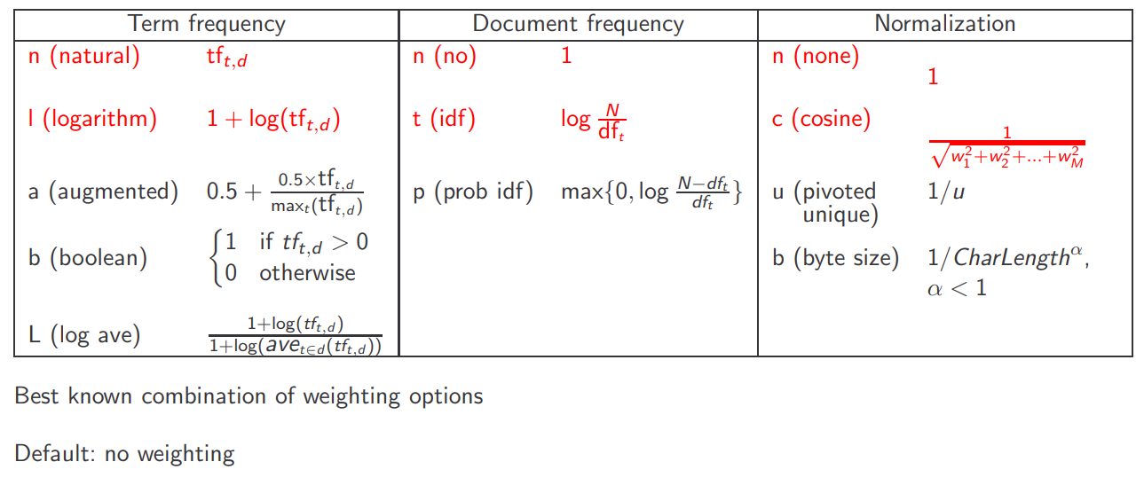
Weighting schemes
Local
Global
Doc length
Document length normalisation

